Slide 1
HYBRID CODEC
Image and video
Designed and Implemented by Malinda Sulochana Silva
Dept. of Electrical and Electronics Engineering
University of Peradeniya.
malinda.silva@eng.pdn.ac.lk

Slide 2

COOL CODEC
The CoolCodec is a c++ implementation for
compress and decompress Image and video files.
There exist separate functions for Encode and
Decode Image and video. The source code is
open sourced and anyone can use, modify or redistribute without any restriction.

Slide 3

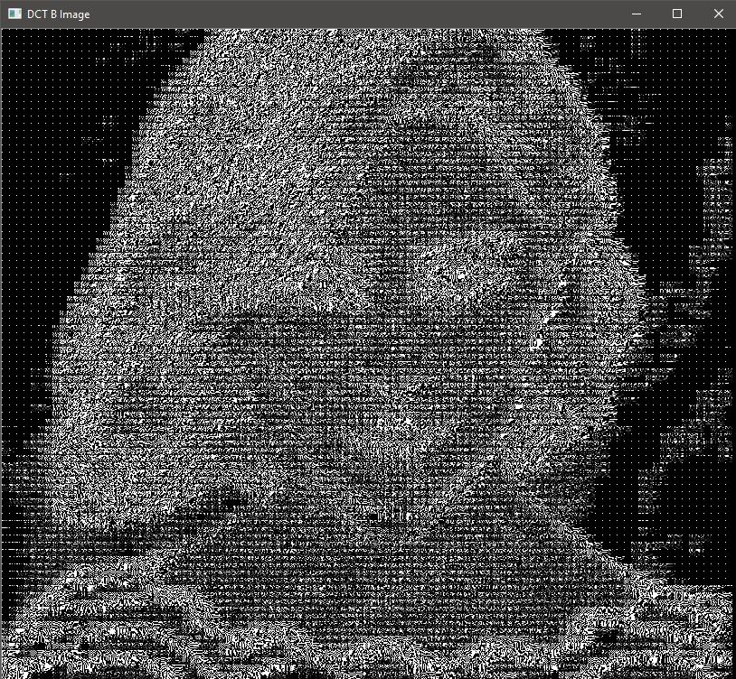

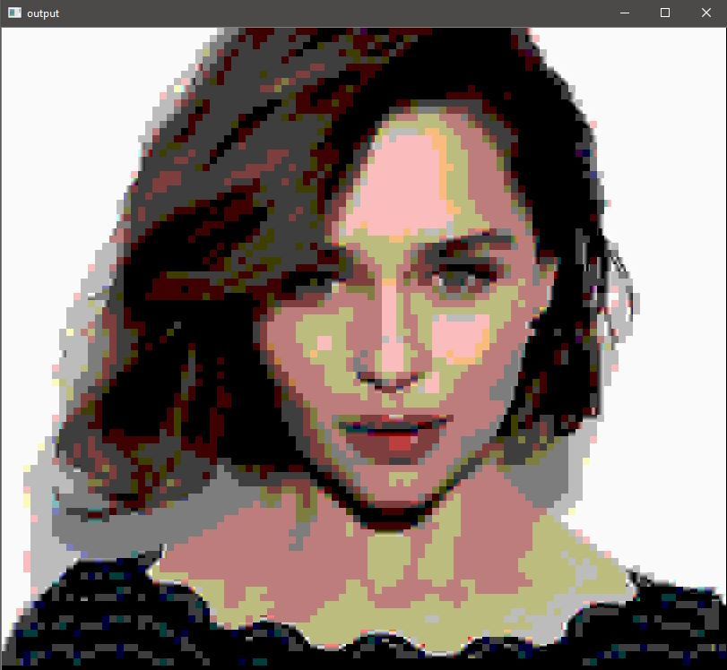
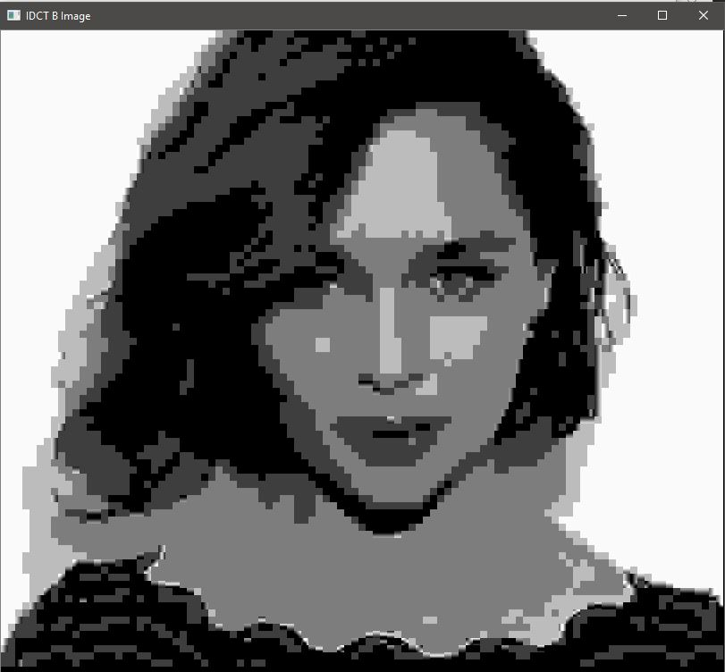
IMAGE CODEC
Huffman Encoding
Input Image
DCT
Quantization
Channel Transmission
Decoded Image
IDCT
Dequantization
Huffman Decoding

Slide 4
FILE WRITING
Writing encoded bitstream bitwise is a challenge since only a byte could be accessed in programming.
So, as a solution an empty byte was taken and then the bits were shifted to fill the byte.
Then the filled byte was written to a file
1 | 0 | 1 | 1 | 1 | 0 | 1 | 0 | << 1011101010
Huffman encoded bitstream
Write byte to a file

Slide 5
FILE READING
1 | 0 | 1 | 1 | 1 | 0 | 1 | 0 | Read First byte (temp)
1 | 0 | 0 | 0 | 0 | 0 | 0 | 0 | AND with 0x80
1 | 0 | 0 | 0 | 0 | 0 | 0 | 0 | Result
0 | 1 | 1 | 1 | 0 | 1 | 0 |  | << 1 (temp)
1 | 0 | 0 | 0 | 0 | 0 | 0 | 0 | AND with 0x80
0 | 0 | 0 | 0 | 0 | 0 | 0 | 0 | Result
1 | 1 | 1 | 0 | 1 | 0 |  |  | << 1 (temp)
Code Accumulation = “10”

Slide 6
ENCODED FILE
104 104 sectn 8 2 sectn -1 000010 -10 001011 -2 000111 -3 001000 -4 10010 -5 01111 -6 001001 -7 001010 0 10100 1 000110 10 000101 11 11011 12 11111 13 000100 14 10111 15 01000 16 11010 17 10110 18 11101 19 01101 2 11001 20 10011 21 11100 22 01011 24 11110 25 01100 26 01010 27 10101 28 000011 29 000000 3 10001 4 01001 5 11000 6 00111 7 000001 8 10000 9 00110 sectn -1 01100 -10 001111 -2 11011 -3 001011 -4 001100 -5 10110 -6 000010 -7 001101 -8 001110 0 01011 1 01001 10 000011 11 11100 12 001000 13 000111 14 10101 15 10001 16 000110 17 11111 18 11000 19 10100 2 01010 20 11110 21 10011 22 01111 23 01101 24 10010 25 000101 26 10000 27 01110 28 000100 29 10111 3 11010 4 01000 5 000001 6 11101 7 11001 8 000000 9 001001 sectn -1 11010 -10 001101 -2 01001 -3 001010 -4 11001 -5 01010 -6 001011 -7 001100 0 11101 1 01000 10 000111 11 11000 12 01101 13 000110 14 11111 15 10100 16 01111 17 11110 18 10011 19 000010 2 000001 20 10001 21 10010 22 000101 23 01110 24 01011 25 000100 26 10111 27 01100 28 000011 29 10110 3 10000 4 00111 5 000000 6 001001 7 11100 8 10101 9 001000 sectn ”¥)JJR”¥=Æ¥)CŒ5)JS¥)JQ#R”¥)R”¥)šR”¥)šR”¥()Q¥)JT¥)@)JR” ¥)JR”¥)JR”¥)JR$
JR”#R”¥”¥)JJR” Ô¥)JR”¥)JR”¥)JS ÁR”a†¥)JR”¥)JR”¥)JR”¥)JR”¥)JPjR”¥¥)JR”
JR”¥)JR”¤£JR”¡AR”¥(8T¥)JR”¥)J$i5)JR”¥)JR”¥)JR”¥)@†¥)JP`‚¥)JR”¥)J
JR”¥)JR”¥2T¥)A©JR” Ô¥)JR”¥)JRƒ =)JR”¥)JR”¥)JR”¥)JR”¥)JR”¥)JJR”¥)JR”¥)JR”¥)JR”¥¥)JR”¥)JR”¥)JR

Slide 7
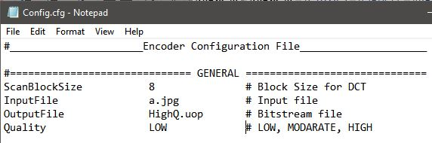
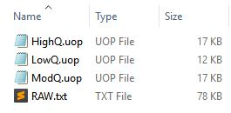

Slide 8
VIDEO CODEC
Input Frame
Image Encoder
Image Buffer
Motion Compensation
Image Decoder
Motion
Vectors
Motion
Estimation
Transmission

Slide 9
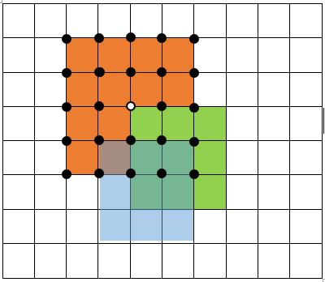
MOTION ESTIMATION
Take mean error of each macro block location.
Check for minimum cost (Minimum error value)
Find (dx, dy) for the macro block location

Slide 10
LITTLE DEMOSTRATION

Slide 11
THANK YOU

